Slide 1
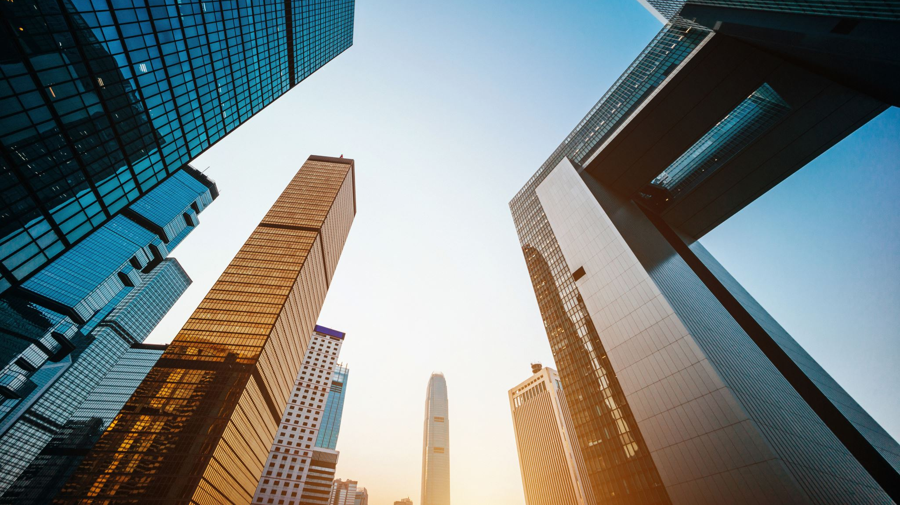
Planning of smart & sustainable cities
BINIT KUMAR MONDAL
Civil Engineering
3RD Year, Section:- B
Roll No. :- 1858136

Slide 2
CONTENTS
Introduction
Why we need to build sustainable cities?
Objectives(Goal 11)
How to make sustainable architecture
Planning of Sustainable Strategies
Smart City
Phase-wise evolution of smart cities
Analyzing Smart City Development in India
ICT for urban management
Area based development models
Selection and Implementation
Challenges facing sustainable architecture
Conclusion
References

Slide 3
INTRODUCTION
Global Report on Human Settlements 2009
Sustainability
Smart Cities
Sustainable development of contemporary cities
Eco-industrial park
Environmental protection

Slide 4

Why do we need to build sustainable cities?
Environmental challenges
Economic changes
Global Demand
Population Growth
Resources’ capitalization
The UN Sustainable Development Goal 11 defines sustainable cities as those that are dedicated to achieving green sustainability, social sustainability and economic sustainability.

Slide 5
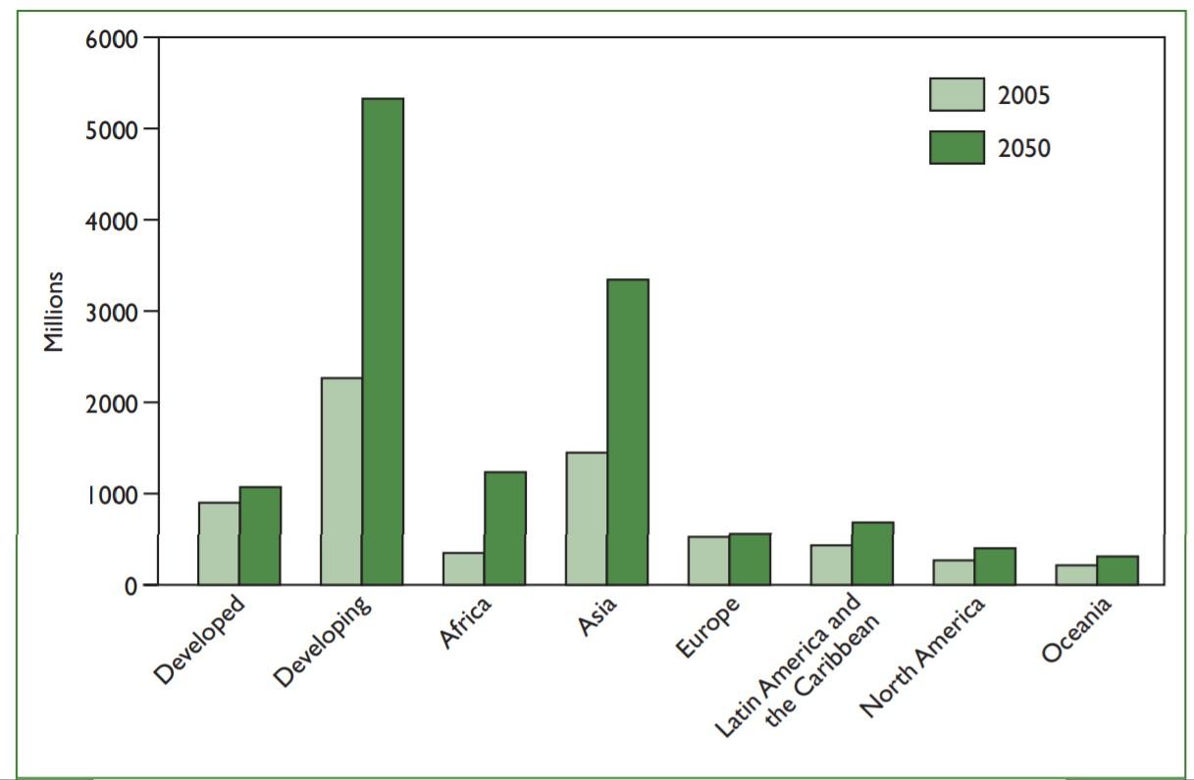
Urban population by
region, 2005–2050
Note:Asia does not include
Japan.
Source: UN, 2008

Slide 6
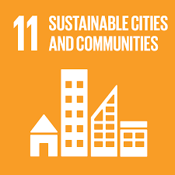
OBJECTIVES
AFFORDABLE AND SUSTAINABLE TRANSPORT SYSTEMS
IMPLEMENT POLICIES FOR INCLUSION, RESOURCE EFFICIENCY AND DISASTER RISK REDUCTION
REDUCE THE ENVIRONMENTAL IMPACT OF CITIES
SUPPORT LEAST DEVELOPED COUNTRIES IN SUSTAINABLE AND RESILIENT BUILDING
REDUCE THE ENVIRONMENTAL IMPACT OF CITIES
INCLUSIVE AND SUSTAINABLE URBANIZATION
PROTECT THE WORLD’S CULTURAL AND NATURAL HERITAGE
SAFE AND AFFORDABLE HOUSING
REDUCE THE ADVERSE EFFECTS OF NATURAL DISASTERS
STRONG NATIONAL AND REGIONAL DEVELOPMENT PLANNING
PROVIDE ACCESS TO SAFE AND INCLUSIVE GREEN AND PUBLIC SPACES

Slide 7
How to make Sustainable architecture
Urban needs
design of enclosed yard areas
Ecological needs
use of environmentally sound materials;
Architectural and planning needs
design of compact form of a plan and avoidance of irregular facade
stylobate floor lay-out to reduce the wind load on the adjacent territory; use of buffer zones in a building from adverse directions
Constructive needs
use of effective thermal insulation materials and structures when erecting a building
Engineering needs
zero-discharge operational cycle of a building enabling to preserve the environment
maximum vertical gardening usage in warm climate
use of alternative energy sources for building engineering
arrangement of buildings in accordance with the orientation under direction
landscaping
design of big-framed buildings relationship of building envelop area and that of window openings in order to reduce power inputs
use of both passive and active alternative energy sources systems in buildings
use of mechanical exhaust system of ventilation with air disposition by thermal pumps for the needs of hot water supply system
use of hot water supply system with local decentralized water preparation in the basement plant room
use of three-layered building envelops
use of local construction and finishing materials when erecting a building
Pre Engineered Steel Buildings

Slide 8
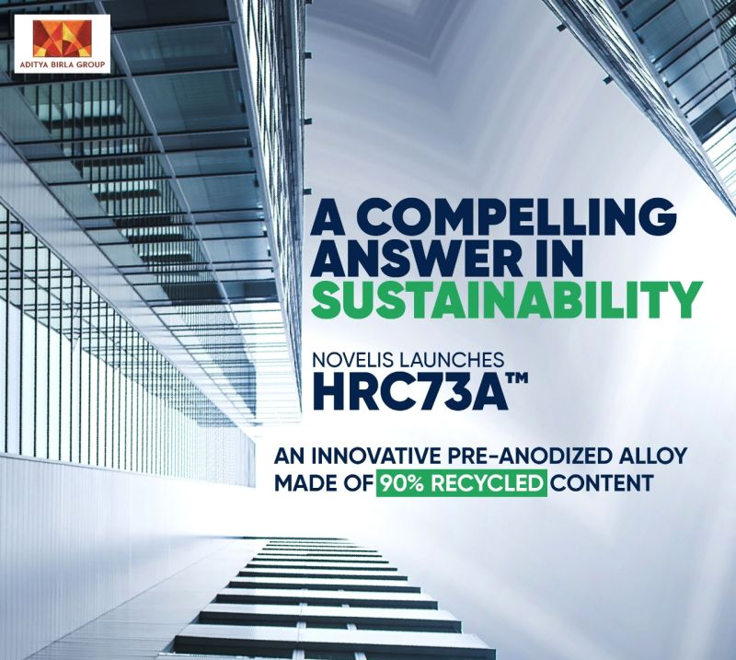
Pre Engineered Steel Buildings
Overall, steel is an expensive material as compared to the rest but when it comes to the cost-savings during the life span of the structure, steel proves to be a very affordable material.
Pre-engineered steel buildings prove to be very economical and environmentally friendly
They result in reduction in factors that are contributing to global warming and pollution and usually save a lot of landfill space and have longer life span
Once the design life is over, most of the pre-engineered steel buildings end up at a recycling center where they are melted and used for the other purposes rather than being dumped at the local available land/ground, thus reducing construction and demolition waste
saves energy, and, as a result of that, it cuts down on heating and cooling bills.

Slide 9
Planning of Sustainable Strategies
PROCESS
ADAPTATION
REGENERATION
Recognize and interpret the historic and cultural significance of the green architecture
Marking of crowded areas
Creating new zones with coherence to existing city
Proper allotments for misplaced people and property
Local sentiments and cultures
Past sources of interests
embodied of a public park
new vegetation strategies
Level of qualification, flexibility to get more opportunities
knowledge about the policies and schemes launches by the govt
perform well in redesigned for
be long lasting and adaptable to new uses
respond well to surroundings and enhance context
have a visual coherence and create ‘delight’ for users and passers-by
be sustainable – non polluting, energy efficient, easily accessible and have a minimal environmental impact

Slide 10
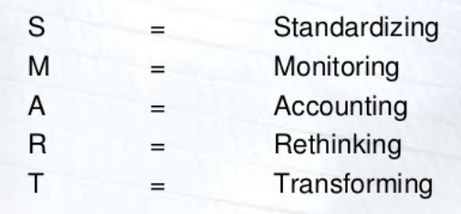
SMART CITY
Basic planned Infrastructures
‘Smart’ solutions for better services
Quality of life
Clean and sustainable Environment
Affordable housing
Health and Education
Sanitation & Solid Waste Management
Efficient urban mobility & public transport

Slide 11
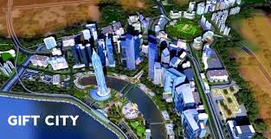
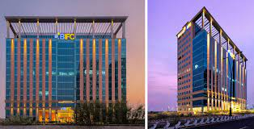
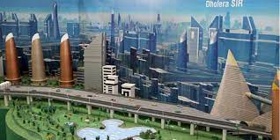
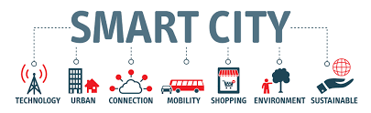
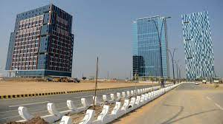
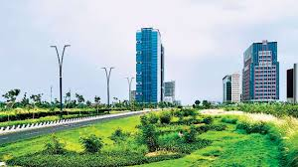
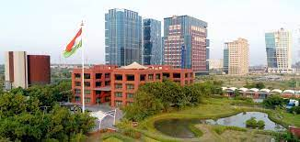

Slide 12
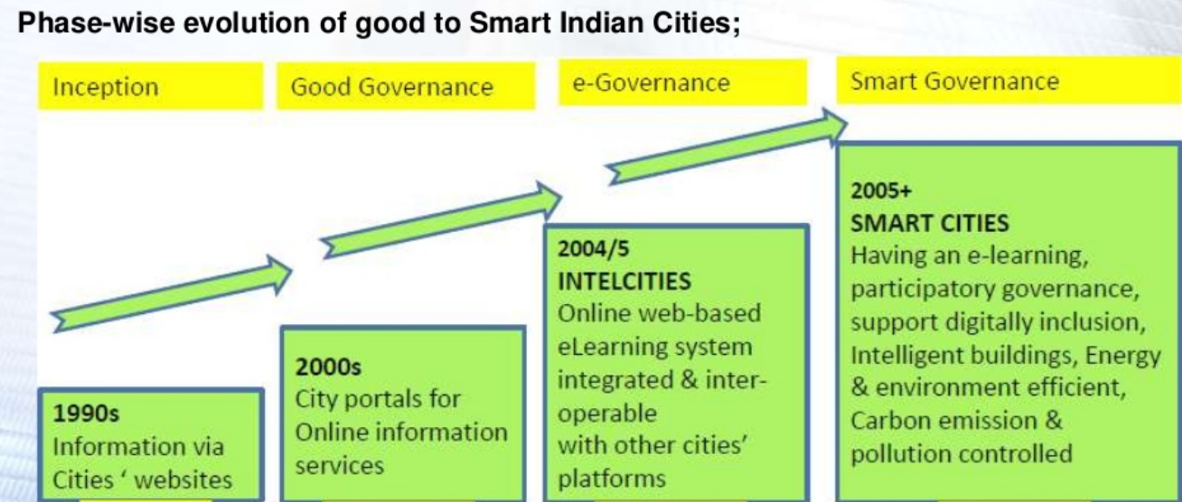
Phase-wise evolution of Smart Cities

Slide 13
Analyzing Smart City Development in India
Jawaharlal Nehru National Urban Renewal Mission (JNNURM)
B&D certification
Property tax Payroll
e-procurement Building plan approval Water and utility payments
SWM Grievance system
Trade licenses Project
Urban Transport
National Mission Mode Project (NMMP)
Large scale investments in the urban sector
Improving services, reducing costs, process time, productivity gains. bettering urban governance
Using ICT in transforming businesses and societies in a significant way.
Delhi Mumbai Industrial Corridor (DMIC):ongoing
first Industrial Corridor project which was announced.
planned urbanization with manufacturing as the key economic driver
Western Dedicated Freight Corridor at its backbone

Slide 14
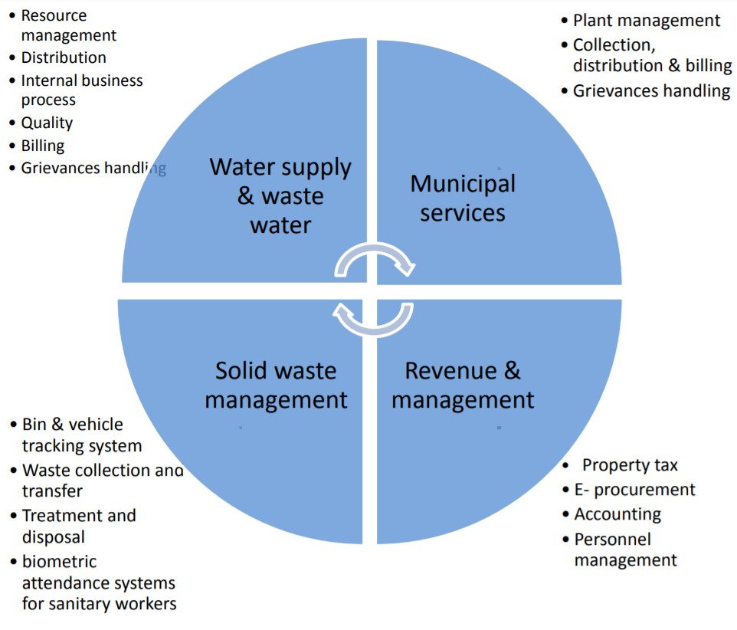
ICT for urban manage-ment

Slide 15
AREA BASED DEVELOPMENT MODELS
GREENFIELD
RETROFITTING
REDEVLOPMENT
Development of an existing built area greater than 500 acres so as to achieve the objective of smart cities mission more efficient and liveable
Replace existing built environment in an area of more than 50 acres and enable co-creation of a new layout especially enhanced infrastructure, mixed land use and increased density
Develop a vacant area more than 250 acres using innovative planning, financing, implementation, with affordable housing for the poor.
Eg. Local Area Development (Ahmedabad
Eg. Bhendi Bazar, Mumbai
Eg. New Town(Kolkata), GIFT City

Slide 16
Selection & Implementation
Stage – 1 :- Cooperative and competitive federalism and Diversity in cities
Stage – 2 :- Intra-State selection on objective criteria to identify cities
Stage – 3 :- All India competition to select smart cities for multiple rounds of selection
Stage – 4 :- The 100 selected cities prepare their Proposals for All India competition with capacity assistance
Stage – 5 :- Winners set-up SPV and start implementation. Preparation of DPRs, tenders etc.
At city level Smart City Advisory Forum will be established.
The Smart City Advisory Forum will include the District Collector, MP, MLA, Mayor, CEO of SPV, local youths, technical experts, and representative of Associations.
The CEO of the SPV will be the convener of theSmart City Forum.

Slide 17
Challenges facing sustainable architecture
Socio-spatial challenges
Demographic challenges
Environmental challenge
Economical challenges
Replacing the conventional anthropocentric thinking by the eco-centric one
Sustainable development is impossible in war and inequality
Humanity needs to develop new ecological technologies that will replace non-ecological ones
Strategy of area-based development
Counter Terrorism
Cyber Security
Citizen Safety (especially for women and children)
Emergency Services (relating to man-made/natural disasters)
Technology Collaboration (to ensure effective implementation of Strategy)

Slide 18
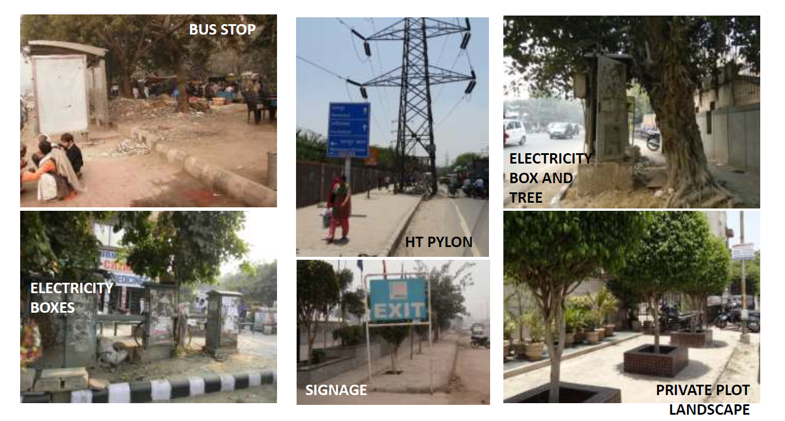

Slide 19
Conclusion
Sustainable architecture produces benefits: social, ecological, and economic. Sustainable urban planning allows reducing negative impact on the environment, minimizing the natural resources consumption and increasing the utilization of renewable resources and wastes and their minimization, reducing operational costs
Accordingly, some specialists like landscape architects, architects, engineers, urban designers and planners play a significant role in achieving sustainable development in cities and countries and in creating appropriate conditions for higher quality of life
There is lots of work doing by the planning and design disciplines to find an appropriate way to figure out the environmental problems caused by urban development. As our cities grow up and cover territories in city periphery green areas now become a part of the city pattern and our daily life. To the beginning of 21-st century the success reached in the field of planning of viable cities and regenerations city territories has opened a new way for projects of green architecture.

Slide 20
REFERENCES
Sustainable Strategies of Urban Planning (By A. Leyzerovaa, E. Sharovarovaa, V. Alekhina )
ScienceDirect(www.sciencedirect.com)
Planning Sustainable Cities: Global Report on Human Settlements 2009, United Nations Human Settlements Programme
Planning Sustainable Cities and Regions: Towards More Equitable Development, by Karen Chapple
Design Solutions for Sustainable Construction of Pre Engineered Steel Buildings (https://doi.org/10.3390/su10061761)
Smart Cities (Article by School of Civil and Environmental Engineering)
Urban Planning and Smart Cities: Interrelations and Reciprocities (by Leonidas G. Anthopoulos and Athena Vakali)
Planning, Development and Management of Sustainable Cities (By Tan Yigitcanlar and Md. Kamruzzaman, Queensland University of Technology)

Slide 21
THANK YOU

